Slide 1

Final Project for CS50 Python
Presenter: Ian Chen
From: Taipei, Taiwan

Slide 2
Project Name: Basic Calculus Calculation System
Are you learning Calculus for the first time? Trying to confirm a calculation you made? Can’t get your hands on an engineering calculator?
Then You’re In Luck!
This program can do the calculations for you! ( the basic ones, at least )

Slide 3
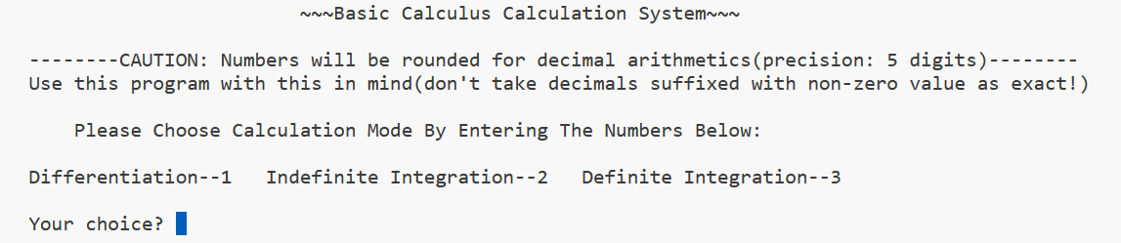
The Calculations we provide
Differentiation (f’(x))
Indefinite Integration
(∫f(x)dx)
3. Definite Integration
(∫a f(x)dx)

Slide 4
How to use it
Input the symbolic number for the desired method ( from pervious slide)
Enter the degree ( natural number) , coefficients ( ints, floats, or fractions) of the function
Confirm the presented function
See result!

Slide 5
Before Using the program
There are some limitations and restrictions you need to know:
1. For floating point digits ( decimals ) , arithmetic results are rounded / presented with 5-digit precision
2. Deals with non-negative integer powers ( e.g. x^4, x, 1 or rather 1 * x^0 )
3. Presents arbitrary constant with C in indefinite integration

Slide 6
Final thoughts
Overall, I’m pretty content with how the project turned out, even though the- re are more features I want to add and potentially some minor bugs/style in- consistencies to be optimized, I thought the project should be concluded for the time being, and I’ll most likely revisit this program in the future when I gain more knowledge on Python/Programming in general. But for now, this was my presentation! Thank you CS50!

